Slide 2
We were created to live out of our DESIGN not just our DESIRES.

Slide 4
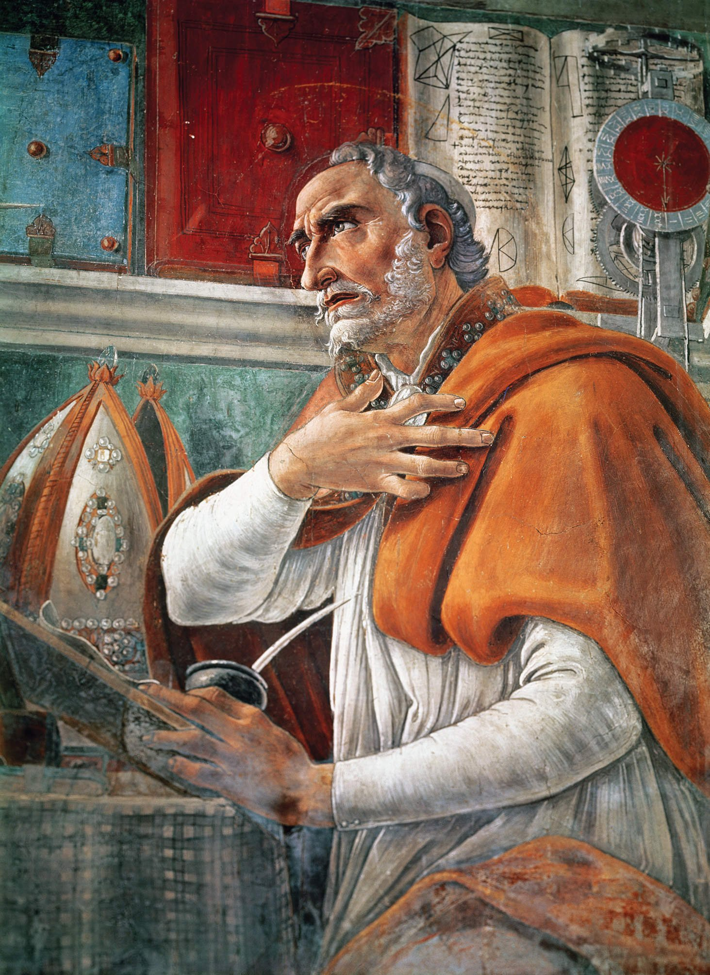

Slide 5
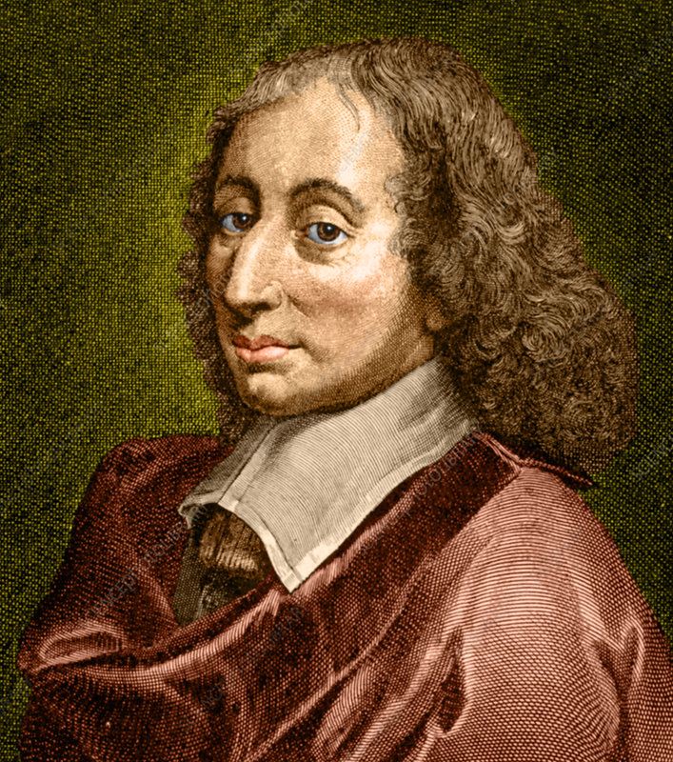

Slide 6
“One of the teachers of the law came and heard them debating. Noticing that Jesus had given them a good answer, he asked him, “Of all the commandments, which is the most important?”
Mark 12:28

Slide 7
613 commands
248 of them were positive laws
365 were negative laws

Slide 8
“Shema” means “hear”
“The Shema” Deuteronomy 6:4-5
“Hear, O Israel: The Lord our God, the Lord is one.”Deuteronomy 6:4

Slide 10
“Love the Lord your God with all your heart and with all your soul and with all your strength.”
Deuteronomy 6:5

Slide 11
You can’t lease God.

Slide 12
Kardia — is the center of your affections and feelings and it includes your will. The power to choose comes from your heart. Your heart chooses what or who you will love.

Slide 13
Your heart determines your eternity.

Slide 14
“Because of your hardness of heart he wrote you this commandment.”
Mark 10:5

Slide 15
“For from within, our of the heart of men, proceed the evil thoughts, sexual sin, thefts, murders, adulteries.”
Mark 7:21

Slide 16
“The good man brings good things out of the good stored up in his heart, and the evil man brings evil things out of the evil stored up in his heart. For out of the overflow of his heart his mouth speaks.”
Luke 6:45

Slide 17
“Moreover, I will give you a new heart and put a new spirit within you; and I will remove the heart of stone from your flesh and give you a heart of flesh.”
Ezekiel 36:26

Slide 18
Sanctification is the continual purifying of your heart by the power of the indwelling presence of the Holy Spirit.

Slide 19
“ . . . sanctify you entirely; and may your spirit and soul and body be preserved complete, without blame at the coming of our Lord Jesus Christ . . .”

Slide 20
“ . . . Faithful is He who calls you, and He also will bring it to pass.”
1 Thessalonians 5:23-24

Slide 21
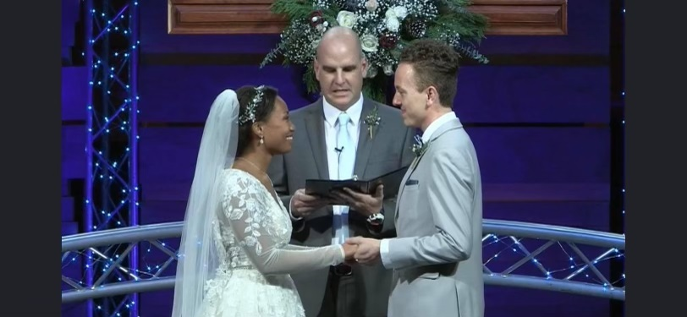

Slide 22
