Slide 2
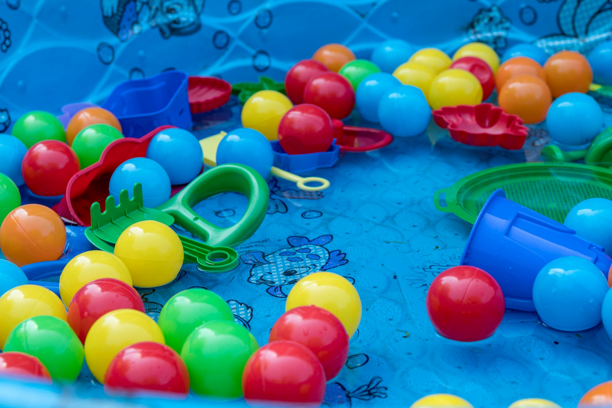

Slide 4
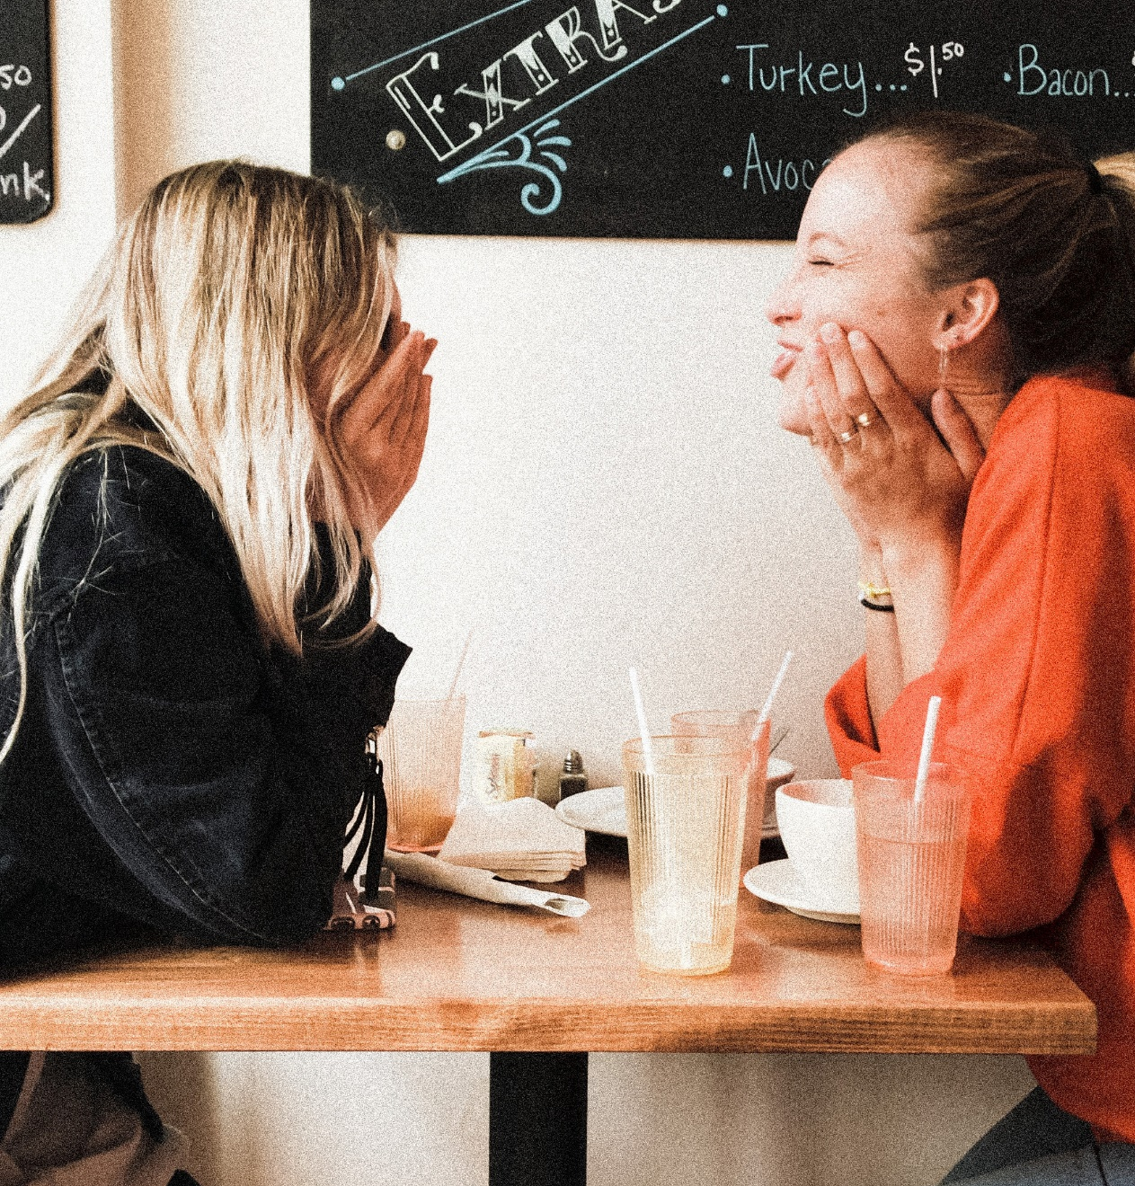
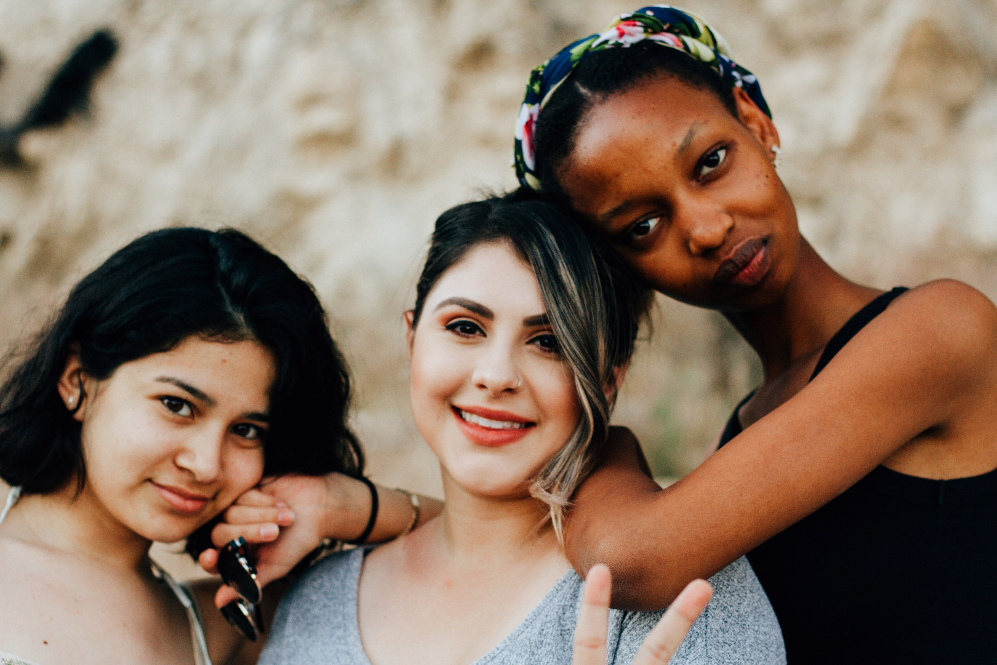
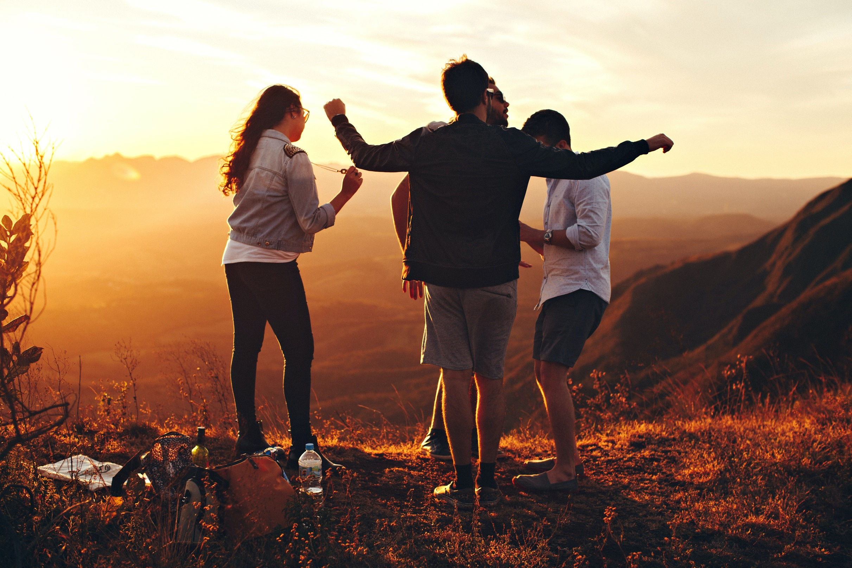

Slide 5
Then God said, “Let Us make humankind
in Our image, after Our likeness,
so they may rule over the fish of the sea
and the birds of the air

Slide 6
over the cattle, and over all the earth,
and over all the creatures that
move on the earth.

Slide 7
God created humankind in His own image,
in the image of God He created them,
male and female He created them.
Genesis 1:26-27 NET

Slide 8
It is not good for the ‘adam’ to be alone. I will make a companion for him who
corresponds to him. Genesis 2:18

Slide 9
No one climbs alone!

Slide 10
We were meant to be known
and loved by God.
We were meant to be known
and loved by others.

Slide 11
Where do I need to recommit
to my relationships?

Slide 12
Join a Southside Group today!
southsidechurchva.org/groups

